Slide 1
Recurrent Networks (Hopfield)
Artificial Intelligence
November 4, 2019

Slide 2
Our Plan
W | 10/23/2019 | Neural Networks | Intro to Neural Networks
M | 10/28/2019 | Machine Learning | Quiz | Quiz 3 (Machine Learning)
W | 10/30/2019 | Neural Networks | Feedforward Networks (Backprop)
M | 11/04/2019 | Neural Networks | Recurrent Networks (Hopfield) | Assignment 3 (Machine Learning)
W | 11/06/2019 | Neural Networks | Self Organizing Maps
M | 11/11/2019 | Deep Learning | Deep Sequence Learning
W | 11/13/2019 | Neural Networks | Quiz | Quiz 4 (Neural Networks)

Slide 3
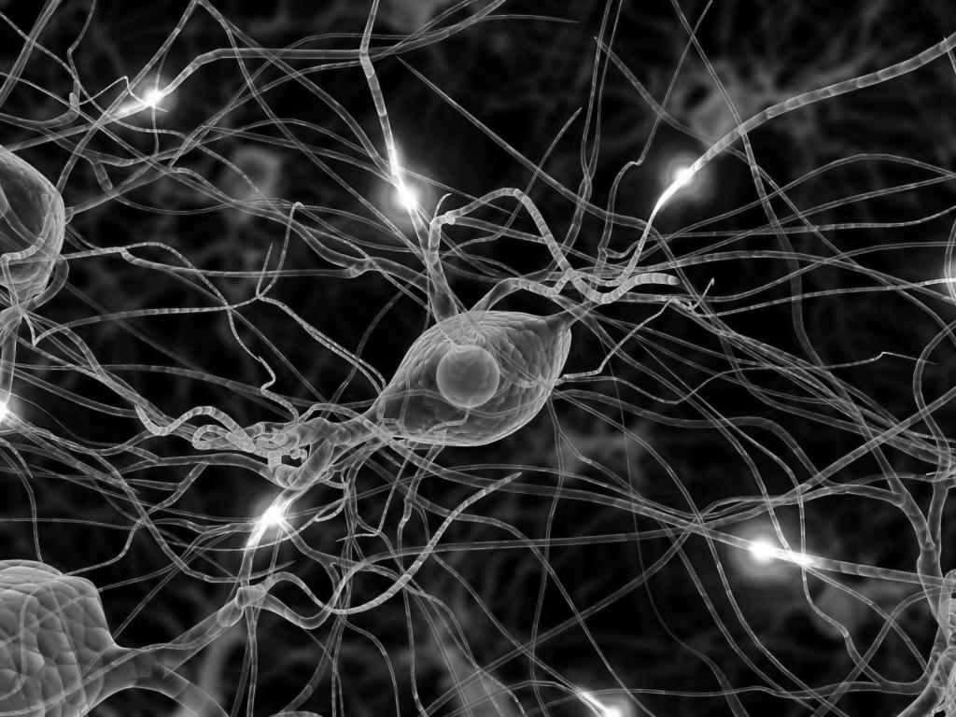
Artificial Neural Networks
Intro to ANNs and the Perceptron
Feedforward Networks (Backprop)
Recurrent Networks (Hopfield)
Self-organizing maps (Kohonen net)

Slide 4
Materials
See Chapter 6 of Yoshimi reading
See slides
See Hopfield handout

Slide 5
Today
Human Memory
Pattern Association & Pattern Completion
Hebbian Learning
The Hopfield Network
Worked example with Hopfield
In-class activity
Analysis of Hopfield Networks

Slide 6
human memory

Slide 7
False memory experiment
bed, rest, awake, tired, dream, wake, snooze, blanket, doze, slumber, snore, nap, peace, yawn, drowsy
bed – primacy effect
drowsy – recency effect
sleep – false memory
pillow – false memory
Roediger, H. L., m., & McDermott, K. B. (1995). Creating false memories: Remembering words not prsented in lists. Journal of Experimental Psychology: Learning, Memory, od Cognition, 2I , 803-

Slide 8
Pattern association and completion

Slide 9
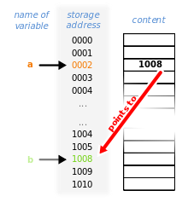
Computer Memories distinguish address from content

Slide 10
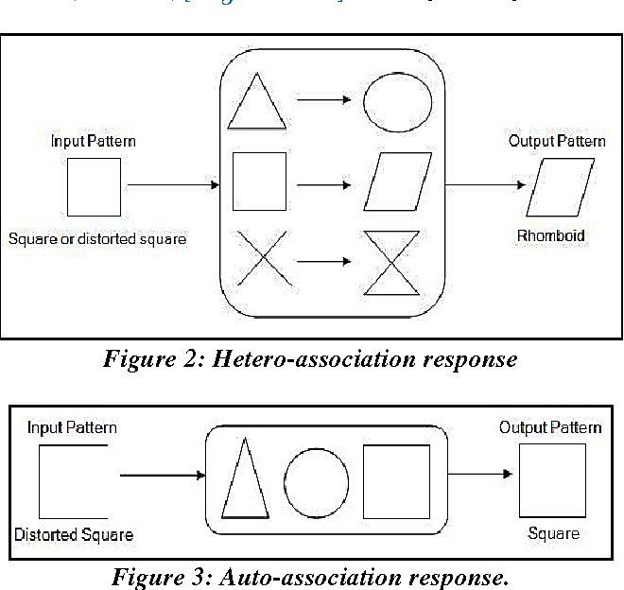
Human memories are content addressable (content is the address)
A content addressable memory is associative
Autoassociative – retrieve a pattern from a fragment
Heteroassociative – associate one pattern with another

Slide 11
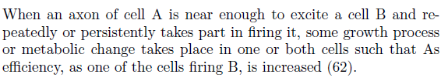
Hebbian Learning (from 1949)
neurons that fire together, wire together

Slide 12
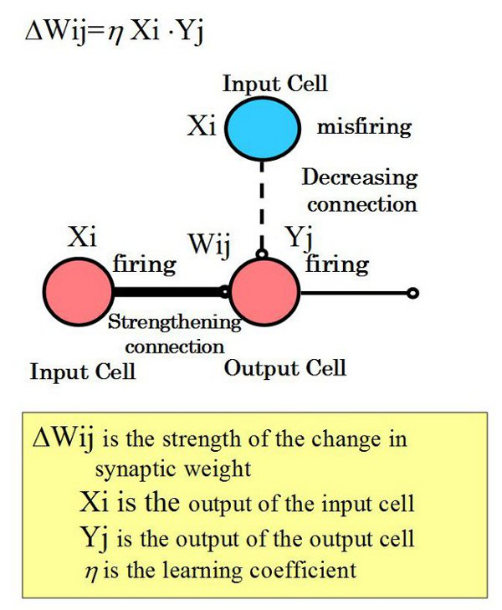
Hebbian Learning

Slide 13
Hopfield network

Slide 14
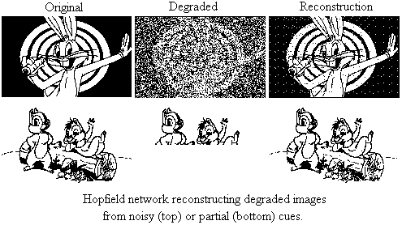
Reconstructing memories

Slide 15
Feedforward vs. Recurrent NNs

Slide 16
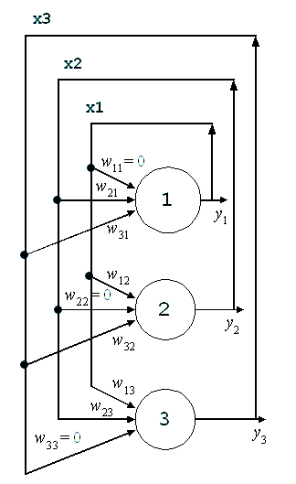
Hopfield Network
Recurrent net
Fixed number of neurons (3 neurons in this example)
Fully connected to other neurons with weights (W21, W31, etc)
No self connections (W11 = 0)
Inputs are X1, X2, X3
Outputs are Y1, Y2, and Y3
Outputs in each step become inputs in the next step (Y1->X1; Y2->X2) – a trajectory

Slide 17
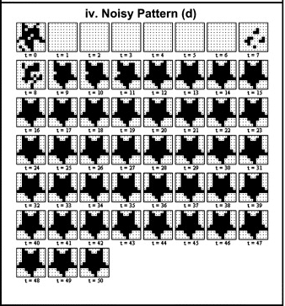
Retrieval is Iterative until Convergence

Slide 18
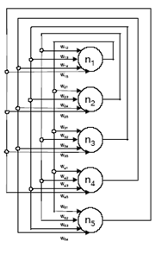
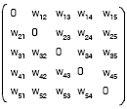
Network Representation – A symmetric weight matrix with no self connections
W_{ij} = W_{ji}

Slide 19
Basic Operations
How to store memories – Hebbian Learning
How to retrieve memories –Perceptron with binary activation
How to update a node in the network
How the overall sequencing of node updates is accomplished
How can you tell if you have converged

Slide 20
Hebbian Learning for storage

Slide 21
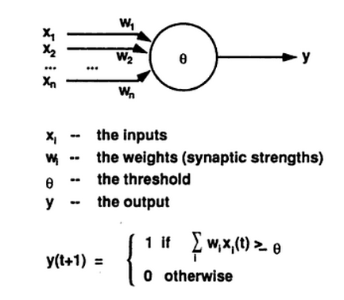
Perceptron with binary activation function for retrieval

Slide 22
Worked example

Slide 23
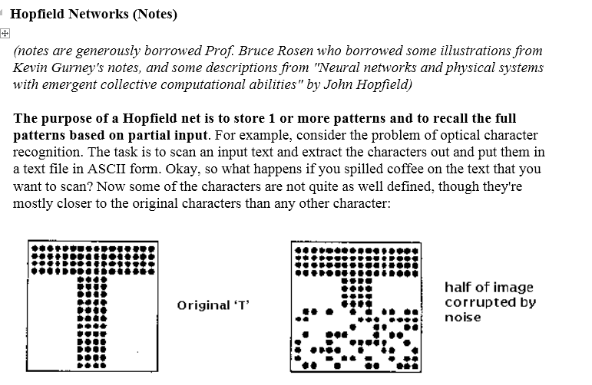
See worked example on Canvas

Slide 24
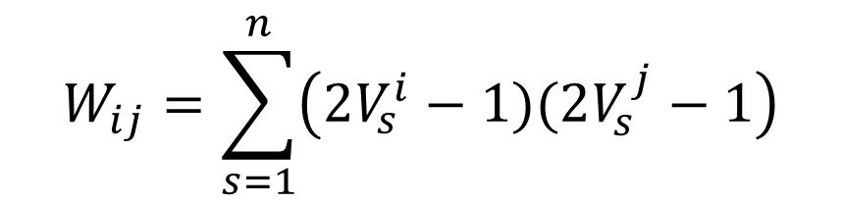
Storing Memories (Training a Network)
$$W_{ij}=\sum_{s=1}^{n}{\left(2V_{s}^{i}−1)(2V_{s}^{j}−1\right)}$$
s is number of patterns
Vs are input patterns
Vi | Vj | Wij
0 | 0 | 1
0 | 1 | -1
1 | 0 | -1
1 | 1 | 1
Hebbian learning: output is 1
when synchronous (rows 1 and 4),
else -1 (rows 2 and 3)

Slide 25
Storing V¹(0,1,1,0,1)
1. Before
2. After
3. Reflecting about
the diagonal

Slide 26
Storing V²(1,0,1,0,1)
3. Before
4. After

Slide 27
Retrieving memories
Start with retrieval cue
Update nodes in network to get modified cue
Set modified cue as new input and repeat until convergence (X1->Y1; X2->Y2, etc)

Slide 28
Updating a node – simple perceptron with binary activation function (0 threshold)
Weighted sum of input from other nodes
If weighted sum >= 0 then 1; else 0 (threshold function)

Slide 29
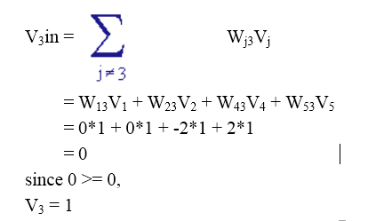
Updating a node: Vin(1,1,1,1,1)

Slide 30
Dot product between input and weights
Vin(1,1,1,1,1)
(W3)
(Vin)

Slide 31
Sequence of updating
All at once – synchronous updating (not realistic)
One node at a time in random order – asynchronous updating (hard to code)
All nodes in a step (iteration) but random order in each step (intermediate solution)
Intermediate solution preferred

Slide 32
Iteration 1: Cue is Vin(1, 1, 1, 1, 1) Random order of update is 3, 1, 5, 2, 4

Slide 33
Iteration 2: Cue is Vin(0, 1, 1, 0, 1) Random order of update is 3, 1, 5, 2, 4

Slide 34
Recap
We stored memories of 5 bits each so we need 5 nodes and 20 connections (no self-connections)
We stored two memories
V1 = (0 1 1 0 1) and V2 = (1 0 1 0 1)
We cued with (1 1 1 1 1) - not the same as a memory
Match to V1 = 2 (hamming distance or number of flipped bits)
Match to V2 = 2 (hamming distance)
The network converged on V1 after a single cycle; cycle 2 needed to verify convergence
Cycle 1: (1 1 1 1 1) -> (0 1 1 0 1)
Cycle 2: (1 0 1 0 1) -> (0 1 1 0 1)

Slide 35
DEMO

Slide 36
in-class activity

Slide 37
ANALYSIS

Slide 38
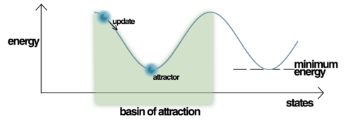
Attractors and basins of attraction

Slide 39
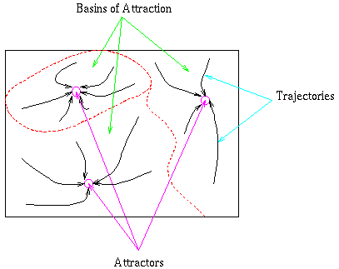
Attractor Landscape

Slide 40
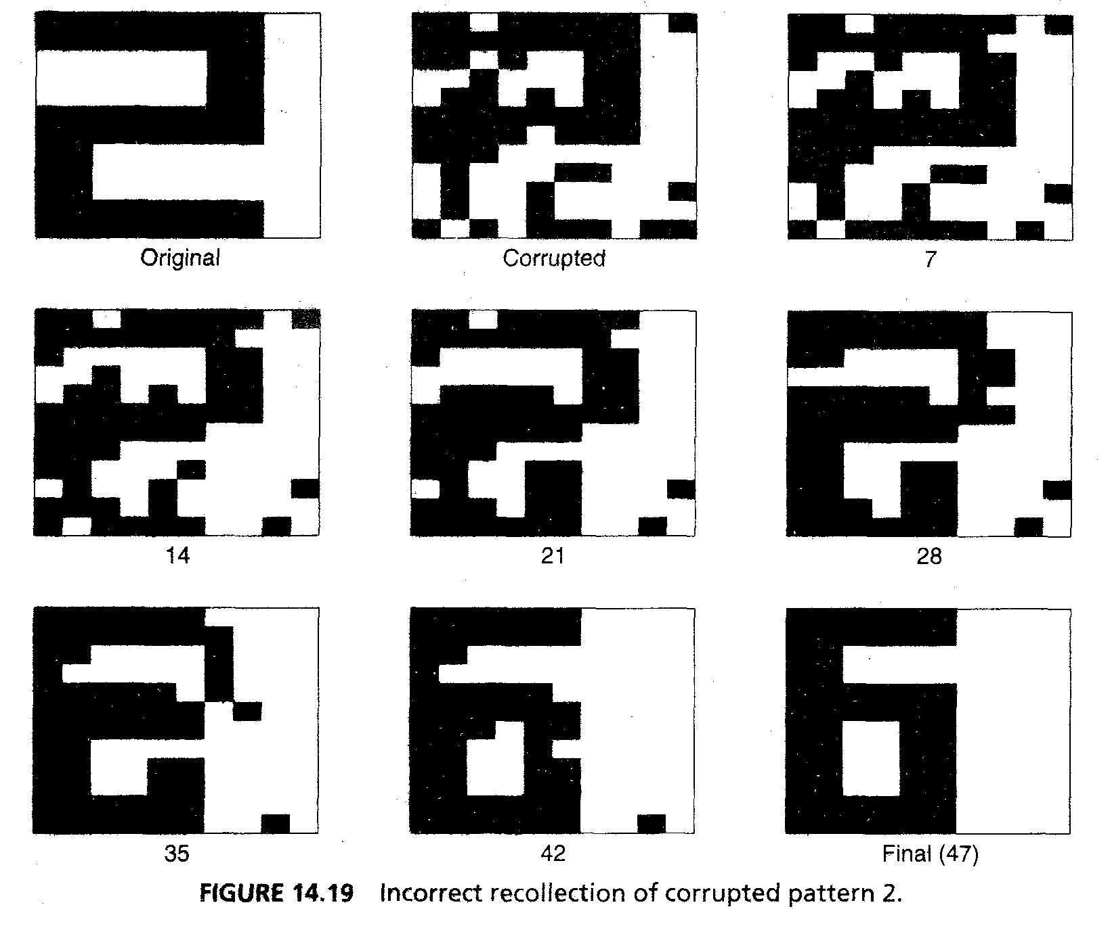
Incorrect recall

Slide 41
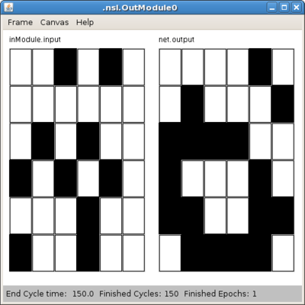
Spurious patterns

Slide 42
review

